Slide 1
Software Engineering
CS20006
Lecture 11
Class and Object Diagrams

Slide 2
Lecture #11
What is a class diagram?
Basic components in any class diagram and their notations
Example: Class Diagram in OLP system
What is an object diagram
Basic components in any object diagram and their notations
Example: Object Diagram in OLP system

Slide 3
Class Diagram

Slide 4
What is a Class Diagram?
A class is a structural component of any object oriented system. The class diagram used to model the structural view of the underlying system
A class diagram is a collection of all possible classes in a system and relationships among them
The different relations may occur in a class diagram are
  Association/Aggregation
  Generalization/Specialization
Class diagrams also show the attributes and operations of a class. also it can depicts the navigability (direction of trace ability) and the constraints that apply to the way objects are connected

Slide 5
Basic Class Model Notations
Class
Example
Notes:
Book

Slide 6
Detail Class Diagram
Class diagram also shows the attributes and operations of classes
Think: For the class Server, what are the attributes? operations?

Slide 7
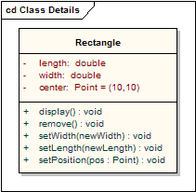
Visibility
The notation that precedes the attribute or operation name indicates the visibility of the element, if the + symbol is used the attribute or operation has a public level of visibility, if a - symbol is used the attribute or operation is private. In addition the # symbol allows an operation or attribute to be defined as protected and the ~ symbol indicates package visibility.

Slide 8
Relation Association
An association implies two model elements have a relationship - usually implemented as an instance variable in one class. This connector may include named roles at each end, cardinality, direction and constraints. Association is the general relationship type between elements. For more than two elements, a diagonal representation toolbox element can be used as well. When code is generated for class diagrams, associations become instance variables in the target class.

Slide 9
Aggregation and Composition

Slide 10
Association Class

Slide 11
Multiplicity
cc

Slide 12
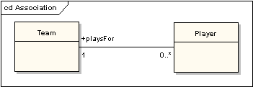
Multiplicity & Association

Slide 13
Example of a Class Diagram

Slide 14
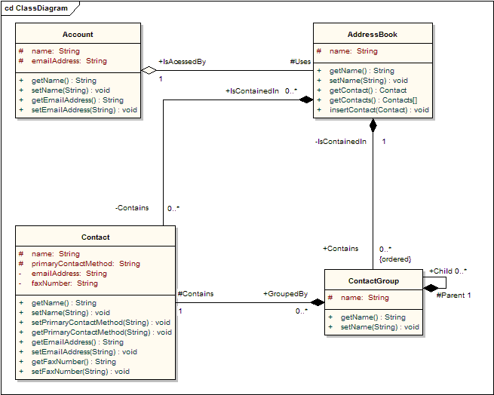
Another Example

Slide 15
Example: Internet
? Internet
  Network of networks (is a collection of servers)
  A collection of web pages
This internet can be thought of an object-oriented system
  ? Use case diagram
  ? Activity diagrams
  ? State-chart diagrams
  etc…..
Let’s consider the class diagram of the system Internet

Slide 16
Example: Internet
This class diagram shows a collection of all possible classes in the system namely, the Internet and relationships among them
This simple class diagram shows the association and aggregation relationship

Slide 17
Interface: Generalization & Specialization

Slide 18
Another view of Internet Class Diagram
This class diagram shows the generalization/specialization relationship

Slide 19
Example: Class Diagram in OLP System

Slide 20
Object Diagram

Slide 21
What is an Object Diagram
An object is an instance of a class
An object diagram is a collection of object and its relationships among them, just like class diagrams
More precisely, an object diagram is a snapshot of the objects in a system at a particular point of time
Since object diagram shows instances rather than classes, an object diagram is often called an instance diagram
Usually, an object diagram is used to provide an example configuration of objects

Slide 22
Example: Object Diagram
Let us consider a composition of a class in OLP system
From the application point of views, the customer class signifies that a customer is either a person or an organization or an employee of an organization

Slide 23
Example: Object Diagram
Further consider a particular snapshot at an instance
    ram: Person
    sita: Person
    bhim: Employee
    arjun: Employee
    oldIndia: Corporate
    newIndia: Corporate
Further assume that bhim and arjun are the employees of oldIndia

Slide 24
Example: Object Diagram
The object diagram for the above snapshot will look like this

Slide 25
More Example: Object Diagram
Let’s consider a small modification in the class diagram
This signifies that a customer being a corporate can purchase for others, say person, organizations

Slide 26
More Example: Object Diagram
A snapshot under this modified situation is
    ram: Person
    sita: Person
    bhim: Employee
    arjun: Employee
    oldIndia: Corporate
    newIndia: Corporate
    india: Corporate
Here, suppose india purchase for oldIndia and newIndia

Slide 27
More Example: Object Diagram

Slide 28
Case Study

Slide 29
Domain class model
  Finding classes
    Keeping the right classes
  Finding associations
    Keeping the right associations
  Finding attributes
    Keeping the right attributes
  Finding methods
Grouping classes into packages

Slide 30
Case Study: ATM System

Slide 31
ATM System: Problem Statement
Design the software to support a computerized banking network including both human cashiers and automatic teller machines (ATMs) to be shared by a consortium of banks. Each bank provides its own computer to maintain its own accounts and process transactions against them. Cashier stations are owned by individual banks and communicate directly with their own bank’s computers. Human cashiers enter account and transaction data.
Automatic teller machines communicate with a central computer that clears transactions with the appropriate banks. An automatic teller machine accepts a cash card, interacts with the user, communicates with the central system to carry out the transaction, dispenses cash, and prints receipts. The system requires appropriate recordkeeping and security provisions. The system must handle concurrent accesses to the same account correctly.
The banks will provide their own software for their own computers; you are to design the software for the ATMs and the network. The cost of the shared system will be apportioned to the banks according to the number of customers with cash cards.

Slide 32
Finding Classes
To find the relevant classes for objects from the problem domain
  Not all classes are explicit in the problem statement
  Some are implicit in the application domain or general knowledge
We can find many classes by considering nouns

Slide 33
ATM System: Find Classes
Design the software to support a computerized banking network including both human cashiers and automatic teller machines (ATMs) to be shared by a consortium of banks. Each bank provides its own computer to maintain its own accounts and process transactions against them. Cashier stations are owned by individual banks and communicate directly with their own bank’s computers. Human cashiers enter account data and transaction data.
Automatic teller machines communicate with a central computer that clears transactions with the appropriate banks. An automatic teller machine accepts a cash card, interacts with the user, communicates with the central system to carry out the transaction, dispenses cash, and prints receipts. The system requires appropriate recordkeeping and security provisions. The system must handle concurrent accesses to the same account correctly.
The banks will provide their own software for their own computers; you are to design the software for the ATMs and the network. The cost of the shared system will be apportioned to the banks according to the number of customers with cash cards.

Slide 34
ATM System: Bad Classes

Slide 35
ATM System: Good Classes

Slide 36
Finding Associations
Apply all or appropriates
  Find Verb phases
  Implicit verb phases
  Knowledge of problem domain

Slide 37
ATM System: Find Associations
Verb phases
Banking Network includes cashier stations and ATMs
Consortium Shares ATMs
Bank provides bank computer
Bank computer maintains accounts
Bank computer process transaction against account
Bank owns cashier Station
Cashier station communicates with bank computer
Cashier enters transaction for account
ATMs communicate with central computer about transaction
Central computer clears transaction with bank
ATM accepts cash card
ATM interacts with user
ATM dispense cash
ATM prints receipts
System handles concurrent access
Bank provide software
Cost apportioned to banks

Slide 38
ATM System: Find Associations
Implicit verb phases
Consortium consists of banks
Bank holds account
Consortium owns central computer
System provides recordkeeping
System provides security
Customers have cash cards
Knowledge of problem domain
Cash card accesses accounts
Bank employs cashiers

Slide 39
ATM System: Class Diagram

Slide 40
Finding Attributes
Consider attributes directly relevant to the application
  Get the most important attributes first
  Add fine details later
  Avoids attributes those are solely for implementation
  Be sure to give each attribute a meaning full name

Slide 41
Keeping Right Attributes
Eliminate unnecessary and incorrect attributes with the following criteria
  Objects
    Careful about right objects as attributes in the class
  Qualifiers
    Which actually matters
  Names
    A name is an attribute when its use does not depends on context

Slide 42
Find Methods
Decide the operations require to manipulate the members within and other objects
Use other models as well
  Sequence diagrams
  Statechart diagrams

Slide 43
Problems to Ponder
For all the geometric objects possible like point, straight line, circle, ellipse etc. obtain the following
  Class diagram
  Object diagram for an instance of object with reference to an instance of a graphics that is drawn based on the geometric objects
Conceptual class diagram?
Domain class diagram?

